Slide 1
Summary of results

Slide 2
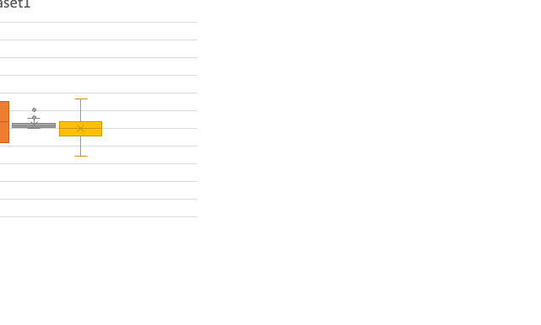
Dataset 1

Slide 3
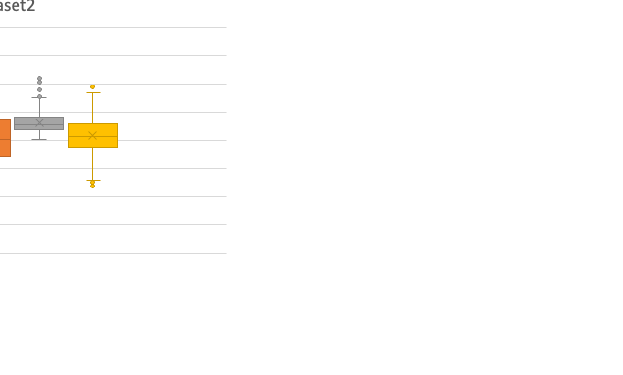
Dataset 2

Slide 4
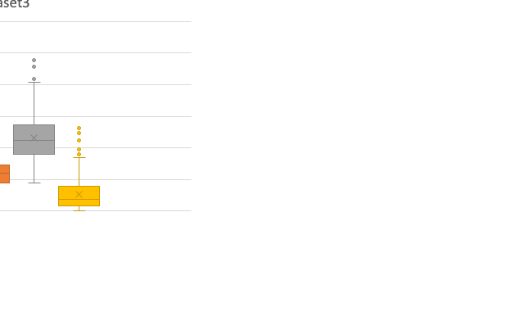
Dataset 3

Slide 5
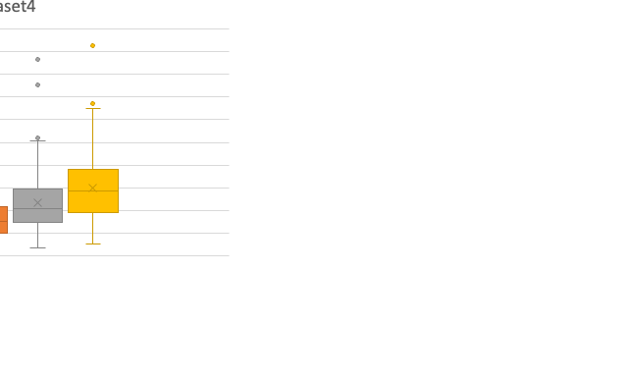
Dataset 4

Slide 6
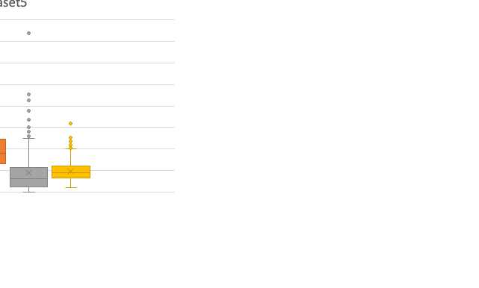
Dataset 5

Slide 7
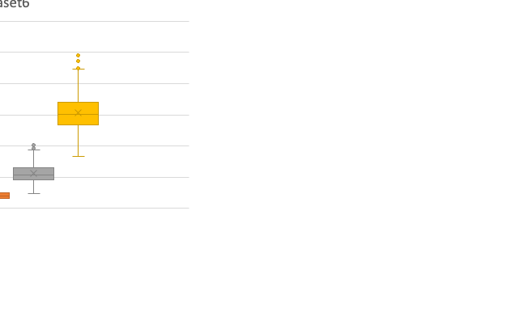
Dataset 6: easy
mu | sigma | mean | var | skewness
2.00 | 0.50 | 8.37 | 19.91 | 1.75
3.00 | 0.33 | 21.23 | 52.98 | 1.07
4.00 | 0.25 | 56.33 | 204.65 | 0.78
5.00 | 0.20 | 151.41 | 935.60 | 0.61

Slide 8
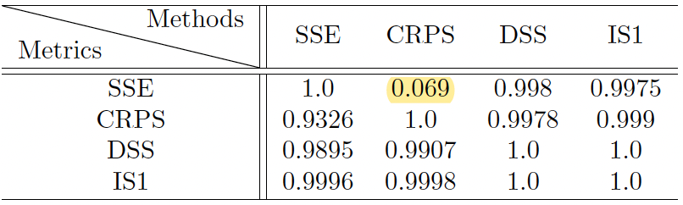
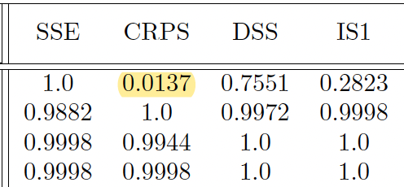
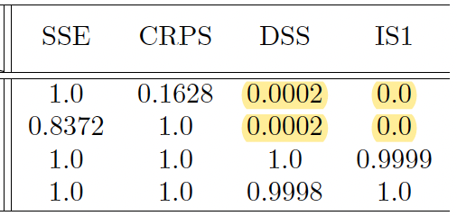
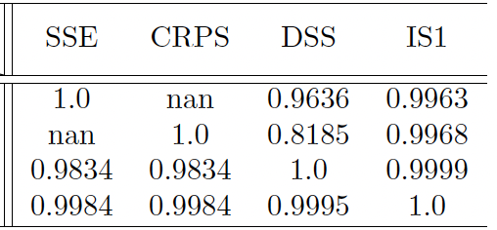
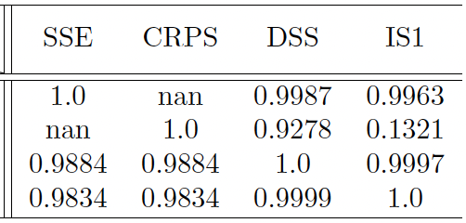
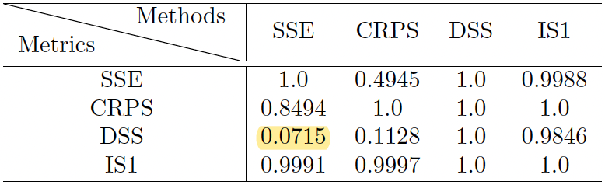
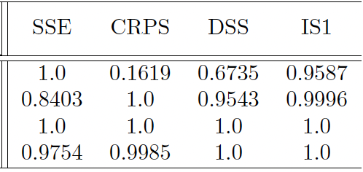
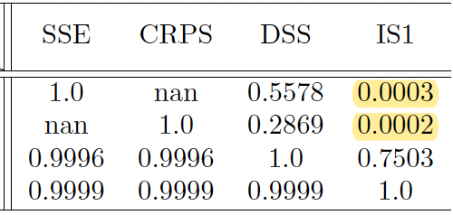
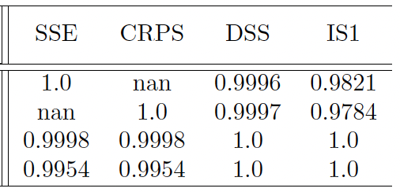
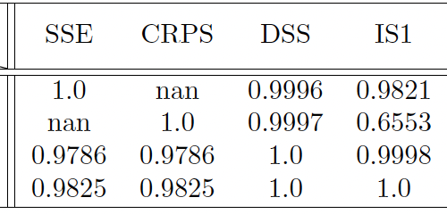
(Test) Data size – 200
0
0.1
0.3
0.5
0.8
(Test) Data size – 800
(Test) Data size – 1600

Slide 9
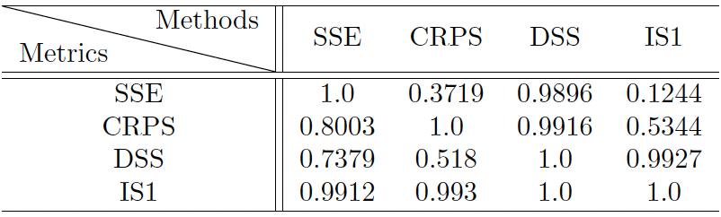
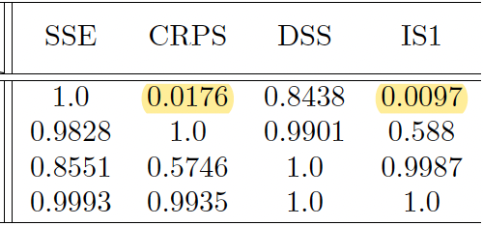
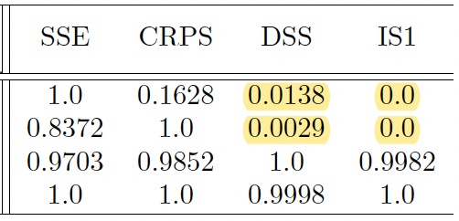
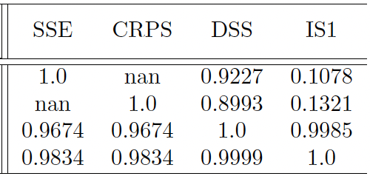
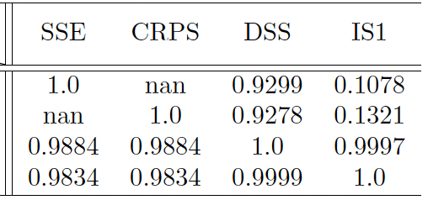
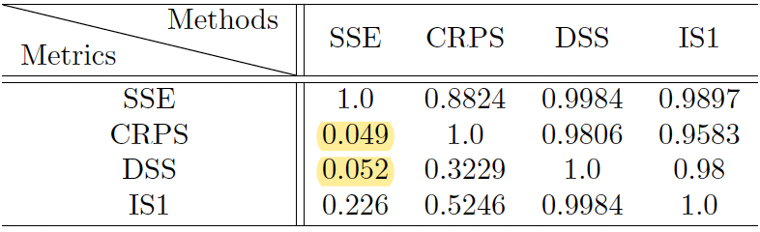
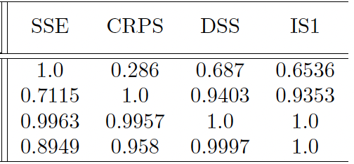
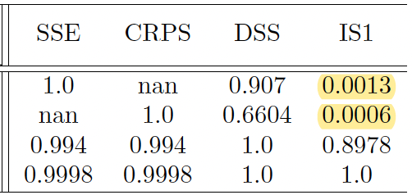
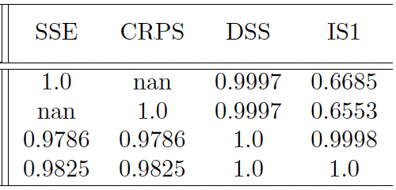
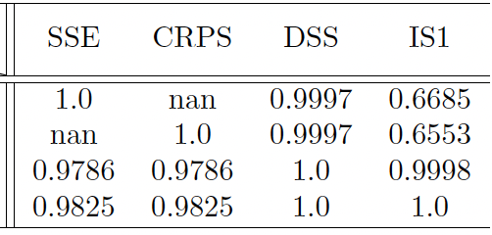
(Train) Data size – 200
0
0.1
0.3
0.5
0.8
(Train) Data size – 400
(Train) Data size – 800
(Train) Data size – 1600

Slide 10
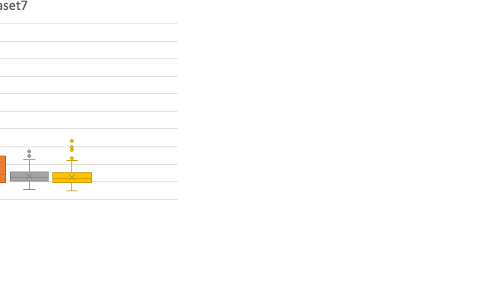
Dataset 7: hard
mu | sigma | mean | var | skewness
0.50 | 0.50 | 1.87 | 0.99 | 1.75
0.33 | 0.60 | 1.67 | 1.21 | 2.26
0.25 | 0.30 | 1.34 | 0.17 | 0.95
0.20 | 0.30 | 1.28 | 0.15 | 0.95
Each red color implies that we found evidence that the tree built with the associated metric was at least not as good as (p-value<0.01 from 30 replications) tree built with another metric when compared in the same metric.

Slide 11
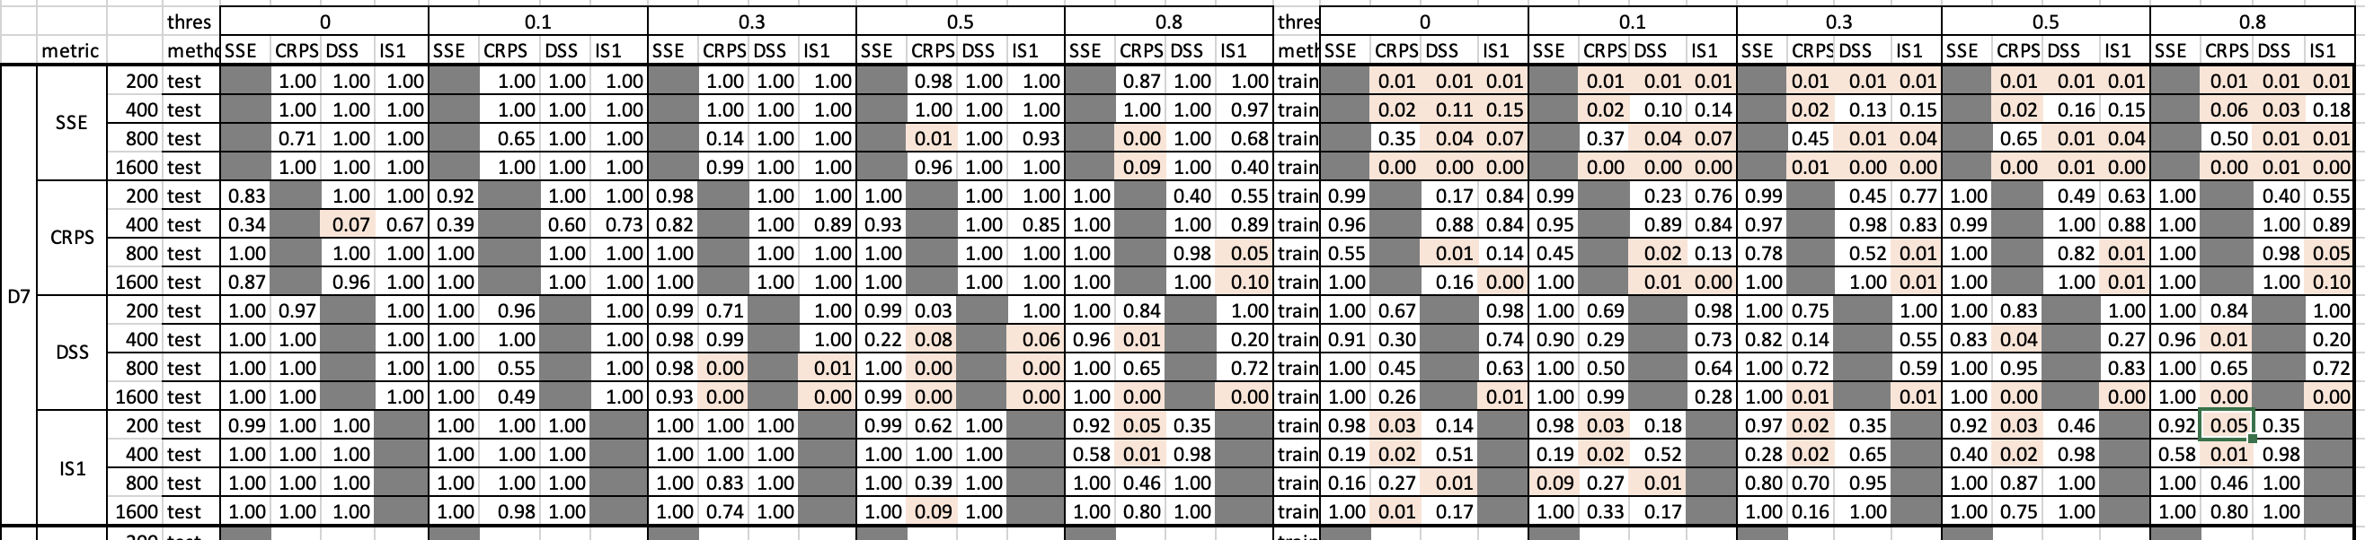
Summary of observations:
Train and test are noticeably different and train is worse than test… why?
As we expect SSE does poorly (on train only though!)
CRPS and IS1 both do better than others and relatively similarly (when test is rejected is for not having evidence that one is better than the other).
Increasing the pruning threshold seems to make things slightly worse (this was not the same for other datasets but also notice, in the train set higher thresholds is better for IS1).
Suggestion for the refined experiment:
Save the data in a single table with X fixed, and Y1 and Y2 changing based on dataset 6 and 7. This will reduce the variability even more.
Use the template above to record the data.
Double check why train is worse than test in the above.
Since interval score is one-sided, we need to avoid distributions that have the support on the reals.

Slide 12
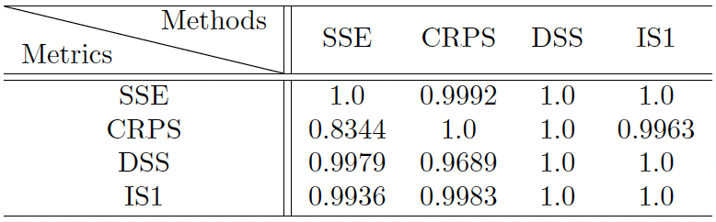
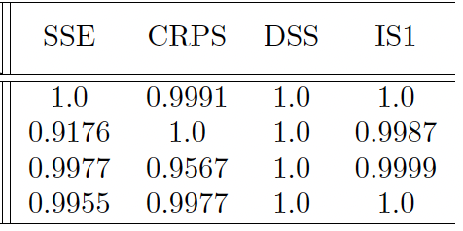
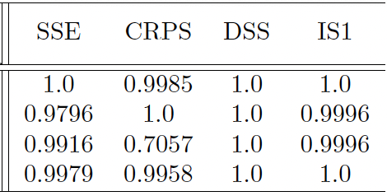
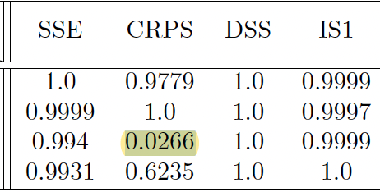
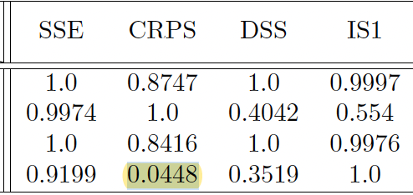
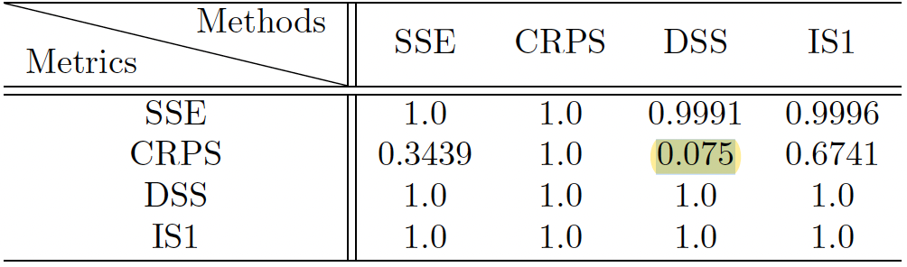
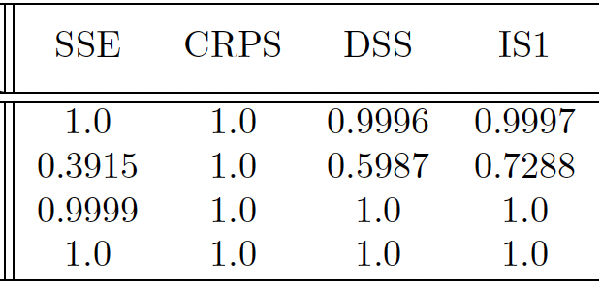
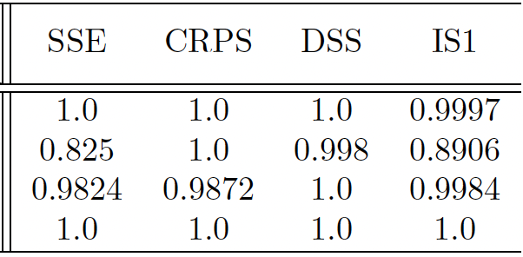
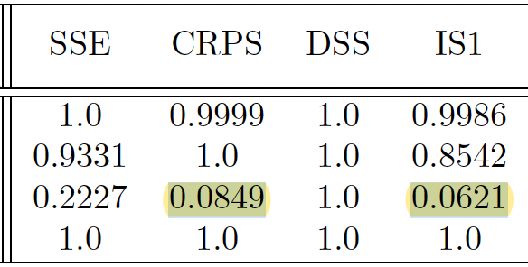
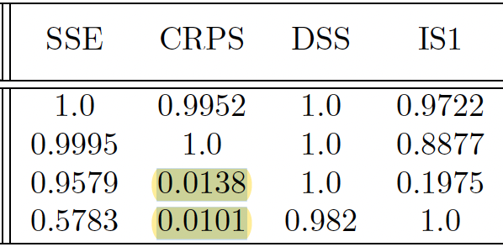
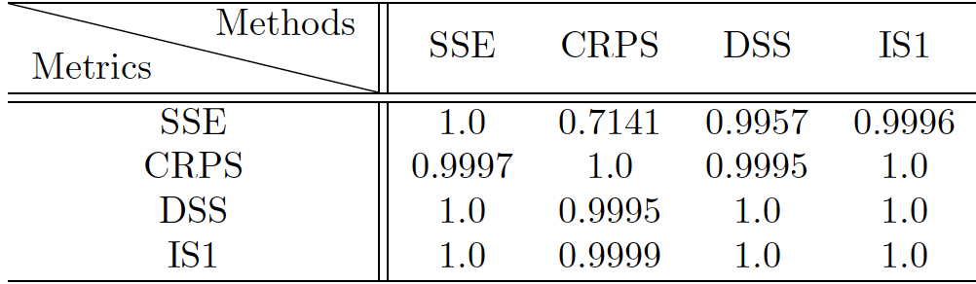
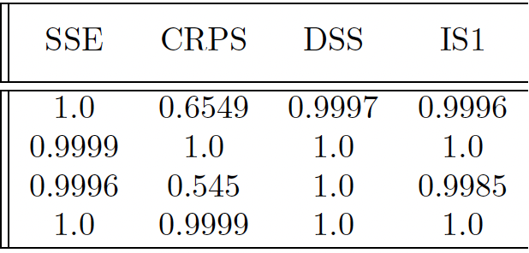
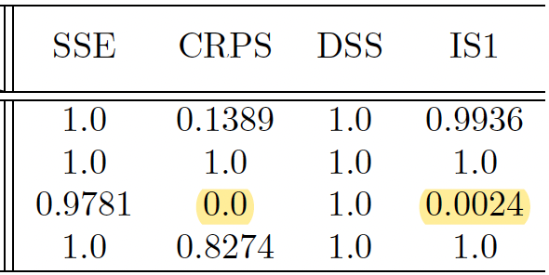
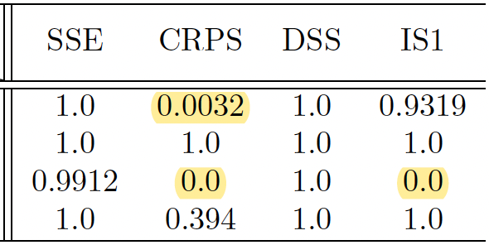
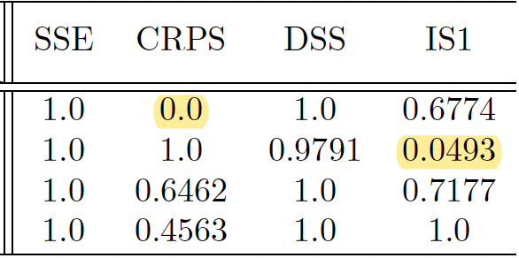
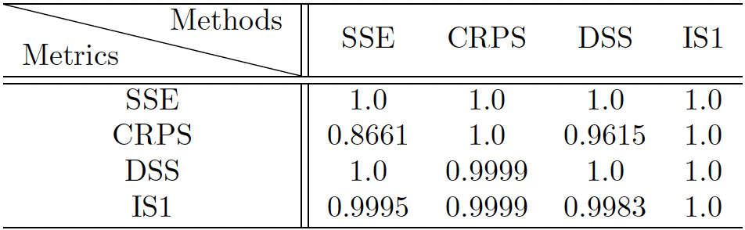
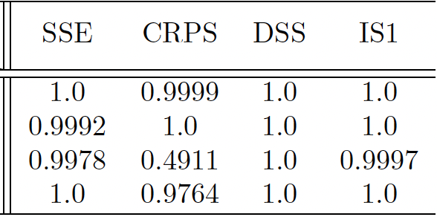
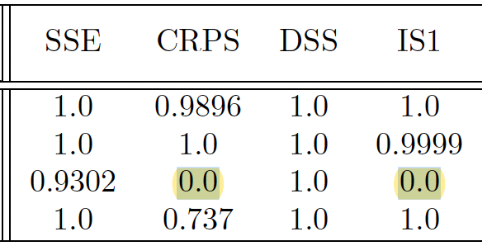
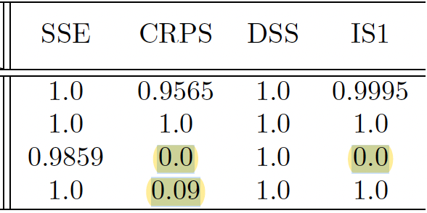
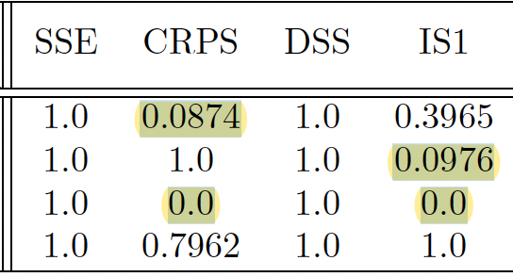
(Test) Data size – 200
0
0.1
0.3
0.5
0.8
(Test) Data size – 400
(Test) Data size – 800
(Test) Data size – 1600

Slide 13
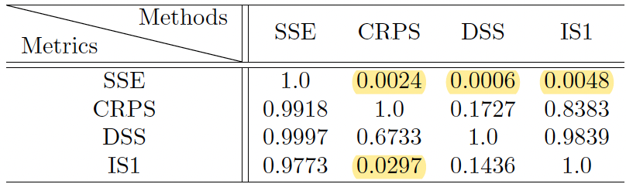
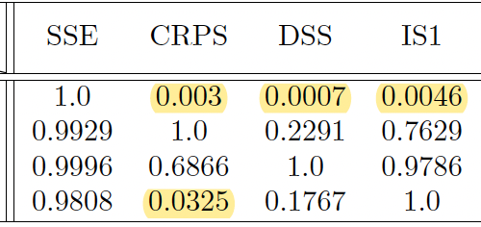


















(Train) Data size – 200
0
0.1
0.3
0.5
0.8
(Train) Data size – 400
(Train) Data size – 800
(Train) Data size – 1600

